Slide 1
TAVO
Group 1:
Adam Zilles, Carsen Pappert, Casper Wang, Jakob El Khoshit, Debadrita Dey

Slide 2
Table of contents
01
02
03
Introduction
Project Topics
Team Processes
04
05
06
Key Findings & Results
Lessons Learned
Conclusion

Slide 3
01
Introduction

Slide 4
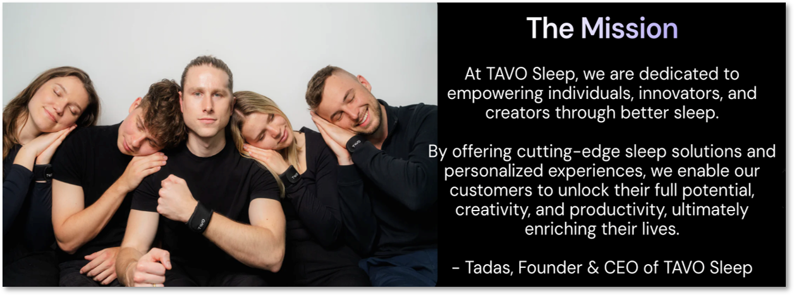
Founded in 2019​
Located in Chicago, IL​
Private​
Electronics B2C ​
Sold $105k worth of product
across 415 orders in 9 months​
Angel investors, loans,
grants ($154k raised in
pre-seed)​
Currently raising a $1.6M
seed round
5 full time employees - designer, supply chain, marketing, tech, CEO
What is TAVO Sleep?
“Reinvent the alarm clock”

Slide 5
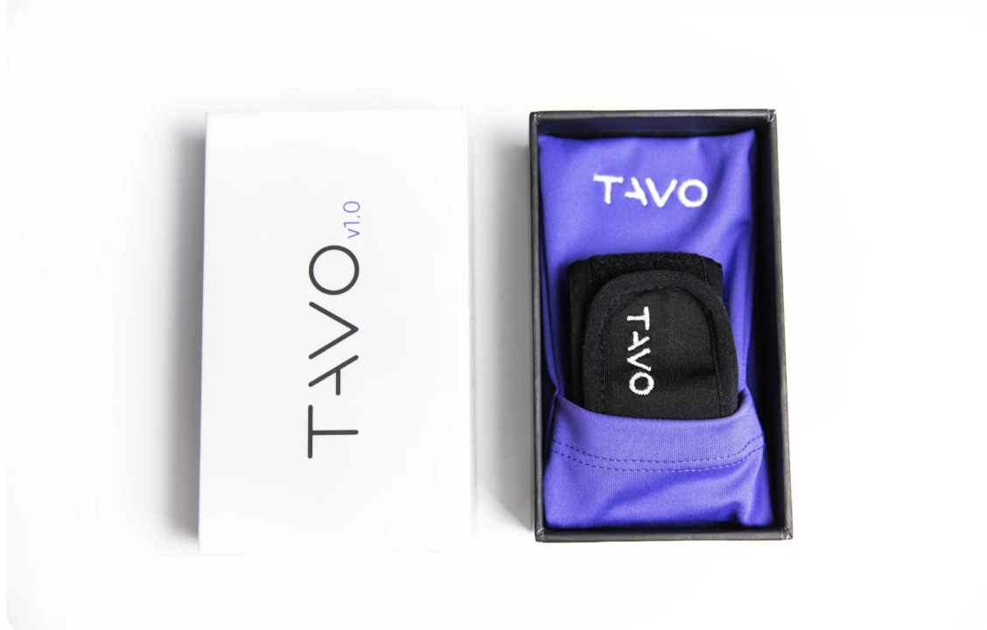
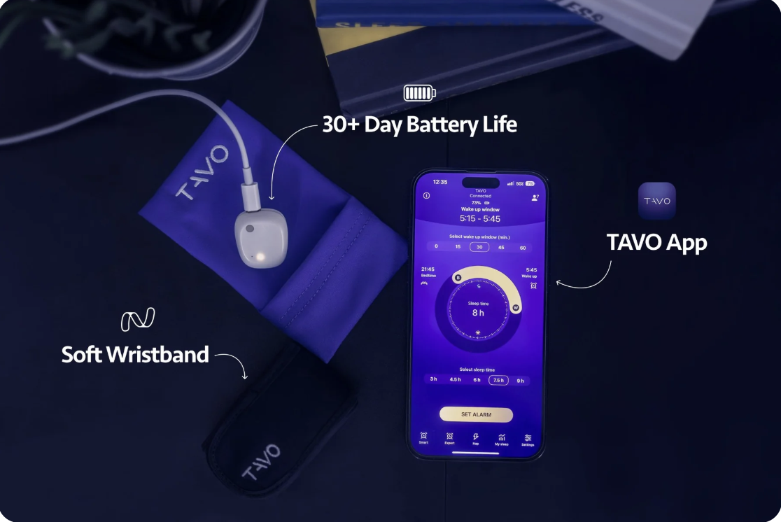
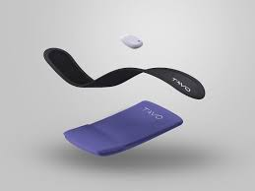

Slide 6
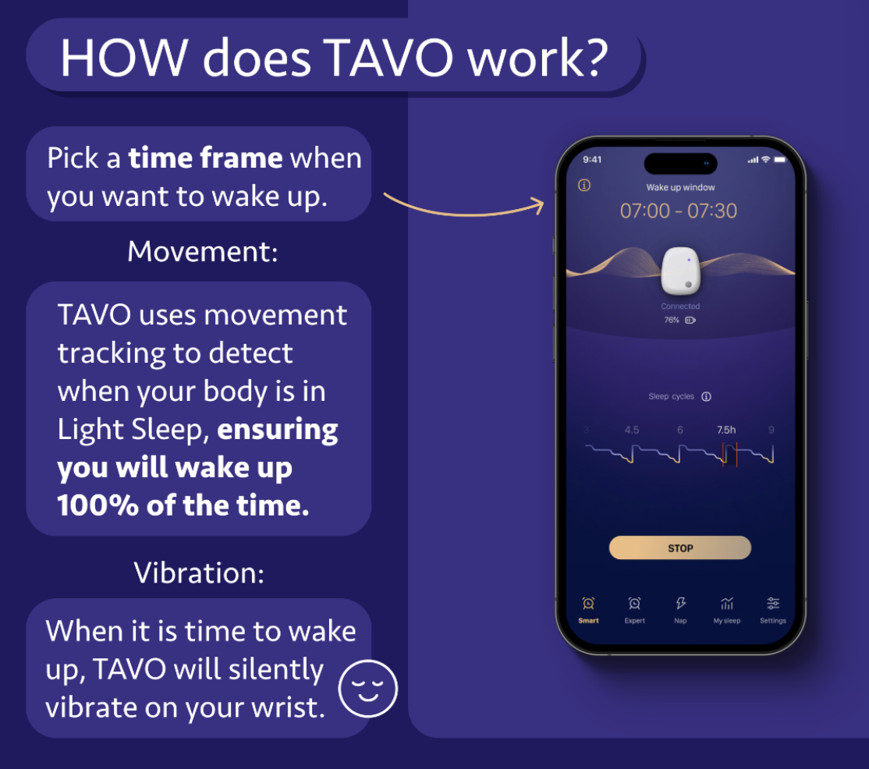
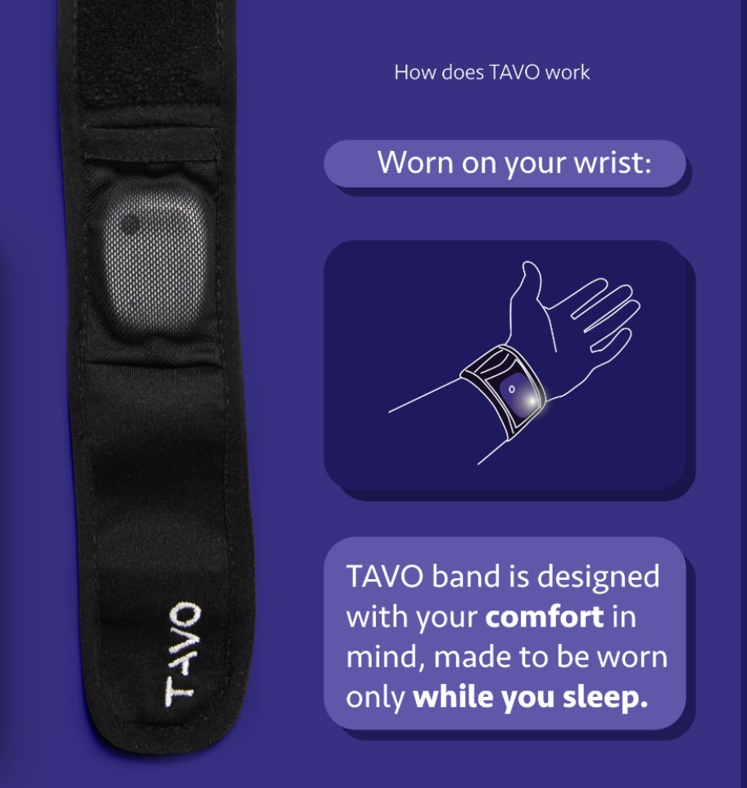

Slide 7


Slide 8
Our Task
Why?
Enhance TAVO Sleep’s relationship with customers by gaining feedback through a more personable and direct method, beyond online reviews.
Highlight the importance of improving customer relationships and feedback for the company’s growth.

Slide 9
02
Project Topics

Slide 10
Overview of our Project
Establishing Scope: Meeting with Tadas (Founder)
Our Deliverable: Customer Feedback Survey
Back and Forth: Refining Survey Questions
Next Steps: Interviewing Customers

Slide 11
Main Objective:
Creating a Customer Feedback Survey
Designed to collect multi-faceted feedback on customer experience with TAVO Sleep.

Slide 12
Aspects of the Survey
1. General Experience
2. Sleep Data and Insights
3. Motivation and Usage
4. Functionality and Features
5. Recommendation and Future Improvements

Slide 13
Challenges
Challenge 1
Challenge 2
Challenge 3
Client Responsiveness
Customer Interactivity
External Factors

Slide 14
03
Team Processes

Slide 15
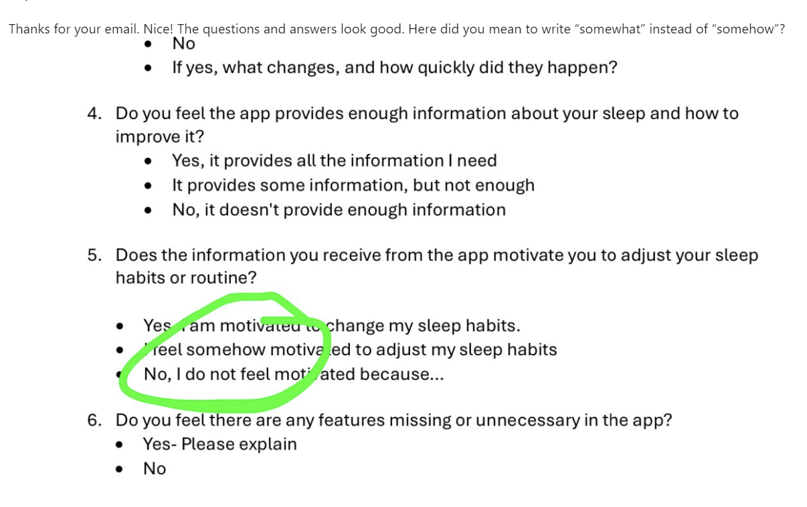
Developing and Refining the Survey Questions
Primary objectives of survey
Gain customer perspectives on the product.
Identify key insights into customer needs.
Filter participants for follow-up interviews.

Slide 16
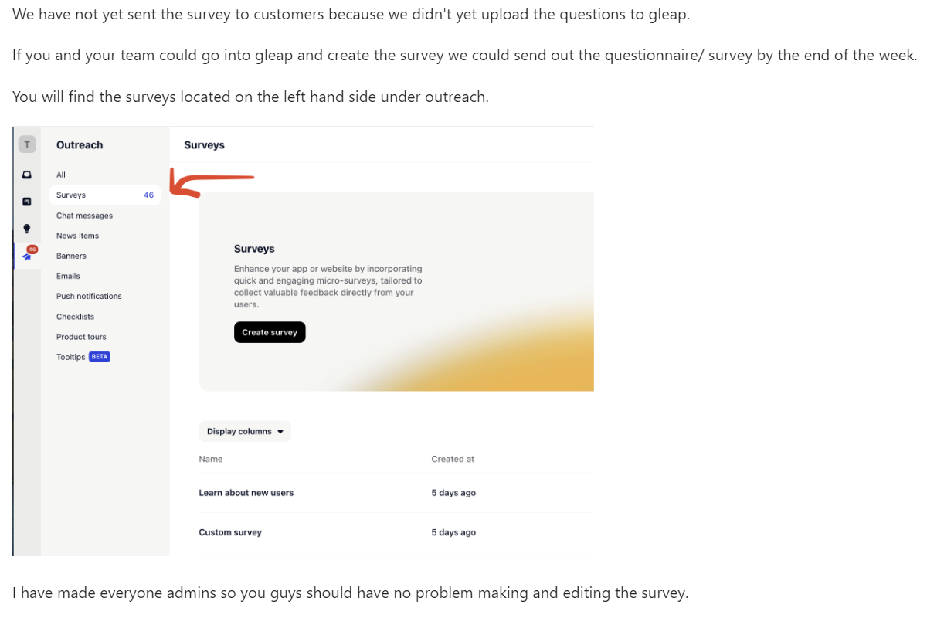
Learning about Gleap and deliver the survey
Introduction to Gleap
Real-time feedback tool designed for apps and websites.
Helps businesses collect and analyze user feedback.
Enhances user experience and drives product improvements.
Benefits of Using Gleap
Improves User Experience: Identifies pain points and areas for improvement.
Boosts Customer Engagement: Involves users in the development process.
Enhances Collaboration: Connects with project management tools for efficient workflows.

Slide 17
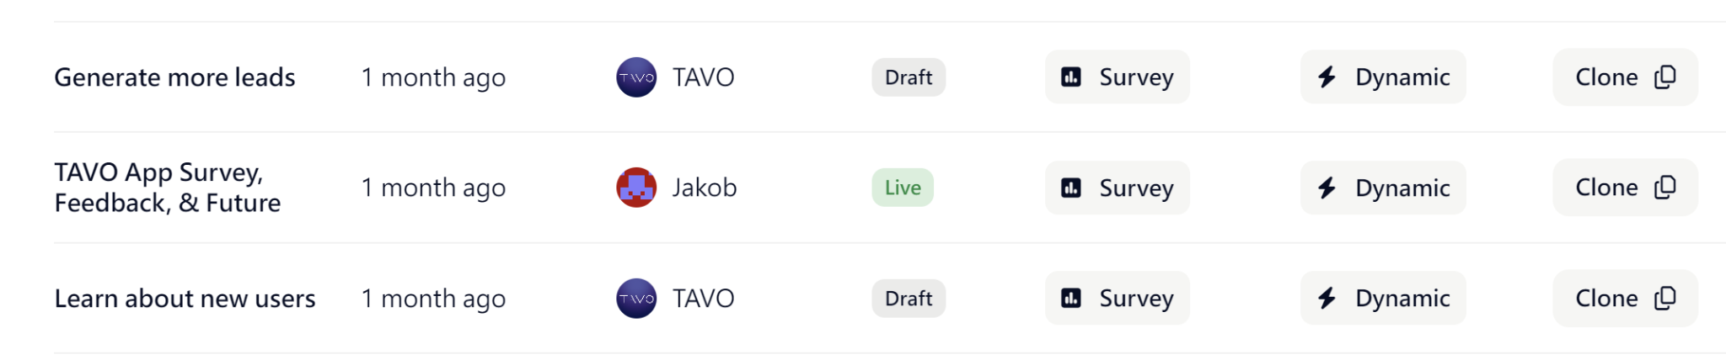

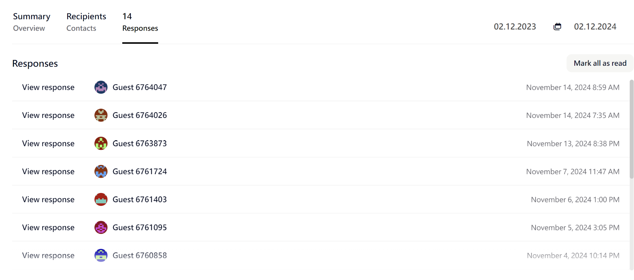
Distributing the Survey and Selecting Customers for Interviews

Slide 18
Interview Process and Feedback
14 Survey responses in total
Contacted all of the people who were willing to be interviewed (6)
Increased odds by doubling the chances to win a voucher
Only 1 response from 1 candidate
Follow up email from Tadas (CEO) to all potential candidates to enhance chances
Response from one potential interviewee (12/2)

Slide 19
04
Key Findings & Results

Slide 20
Key Insights from Survey Development
General Usage & Experience
Price
Alarm Functionality
Data & Statistics
Overall Satisfaction
Suggestions for Improvement

Slide 21
Results
Alarm Feature
Sleep data
App bugs
Compatibility
Recurring Alarms
Customers appreciate the alarm feature for a gentle wake up
Participants express a strong desire for detailed sleep data
Complaints about app functionality and clarity in sleep data
Integration with similar devices (Oura ring)
To avoid setting daily alarms

Slide 22
Results / Customer responses
Q: Do you think there are any features missing or unnecessary in the app?
“The alarm works for waking up but I wish tavo could pair with oura ring or something to actually get sleep data. I get no info about sleep quality from Tavo app.”
“Setting recurring alarms. I don't like having to set my alarm every night - it would be helpful to just set an alarm for each weekday or every day ahead of time.”
Q: Is the data easy to understand and valuable for you?
“No, I don’t think any of the sleep quality data seems accurate, I only use for alarm feature.”
“I am not sure what data is tracking and why it is meaningful to me.”

Slide 23
Expected Impact
Improvements in app functionality and compatibility with similar products
Improvements in sleep tracking and alarm functionality
Investments in R&D for enhanced sleep tracking
Incremental improvements in sleep tracking or partnerships with tech providers
Customers feel valued if individual feedback/complaints are taken into account
Increases customer loyalty and retention

Slide 24
Update per 12/10/2024
Contacted potential interviewee (see Slide 18)
Waited for over 20 minutes on Zoom but customer did not show up
Apologized and asked for a new date
→ when trying to arrange a new date with customer, we received no response
Recontacted another interviewee as requested from Tadas (CEO)
Unfortunately no response and therefore no individual interview with clients could be conducted

Slide 25
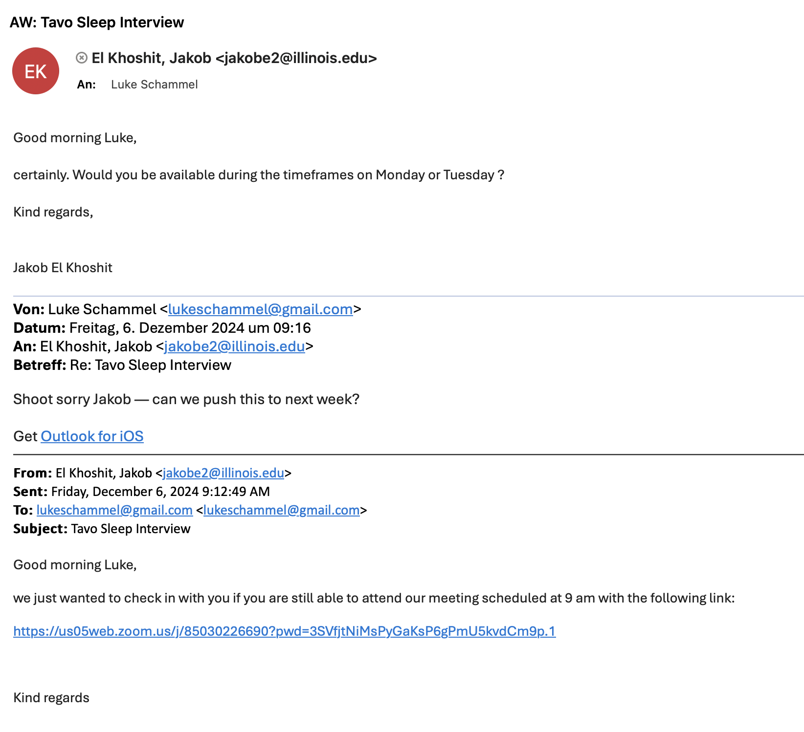
Update per 12/10/2024

Slide 26
Updated impact and conclusion
Introduction of smart alarms and recurring alarms that can adapt customers’ sleep patterns
Upgrade on sensors on the wristband for enhanced sleep tracking capabilities
Collaboration with Oura ring (e.g., bundle packaging or tailored discounts )
→ highlighting mutual benefits and improvement in Oura’s USP
Providing comprehensive reports for customers (e.g., sleep quality, trends) with the help of AI
Implement regular updates on app to avoid app bugs and complaints

Slide 27
Updated impact and conclusion
Overall customer satisfaction with product and alarm functionality
Addressing complaints about sleep data and accuracy of data
Simplifying data presentation
Strengthen product credibility with strategic partnerships
Conducting similar surveys for continuous product improvements & customer satisfaction

Slide 28
Potential feature Tavo sleep can work on
Integration with Wearable Devices:
This feature will enable compatibility with smartwatches and other wearable devices, offering more comprehensive sleep tracking and insights. It will also enhance convenience for users who regularly wear these devices, seamlessly integrating their daily routines with the app's functionality.
Advanced Motion Analytics:
Offer detailed motion tracking to give users a clearer understanding of their sleep disturbances and patterns.
Enhanced Visualizations and Gamified Features:
Enhance the graphical representation of sleep data with interactive charts, engaging animations, and visually appealing designs to make the information easier to understand and more enjoyable to review. Incorporate gamified elements, such as streak tracking to reward consistent use, and personalized messages like “We miss you!” to re-engage users who haven’t checked their data in a while, creating a playful and engaging user experience.

Slide 29
05
Lessons Learned

Slide 30
Key Takeaway 1: Project Planning and Timing
1
2
3
4
5
Initial Meeting
Research and Feedback
Survey Distribution
Data Collection
Final Interview
Create a detailed project plan from the beginning, including specific deadlines for deliverables and scheduled communication checkpoints.
Ensure proper time management to prevent running out of time.
Provide opportunities for adjustments and allow additional opportunities to reach the final interview stage.

Slide 31
Key Takeaway 2: Survey Response Challenges
Explanation
Course Topic
Gathering a substantial number of meaningful survey responses was our biggest challenge
Emphasizes the need for more targeted strategies to engage customers effectively.
Building an Entrepreneurial Network:
Connecting with a broad network of potential customers can increase survey reach and response rates.
Strong relationships with industry partners, influencers, and existing customers can improve future survey responses.

Slide 32
Key Takeaway 3: Unique Selling Proposition
Explanation
Course Topic
TAVO Sleep delivers personalized, science-backed sleep solutions that use innovative technology and premium comfort to help individuals improve their sleep quality for long-lasting health benefits.
Sets them apart in the sleep technology industry
Idea/Opportunity Generation:
Using passive search as a discovery opportunity

Slide 33
06
Conclusion

Slide 34
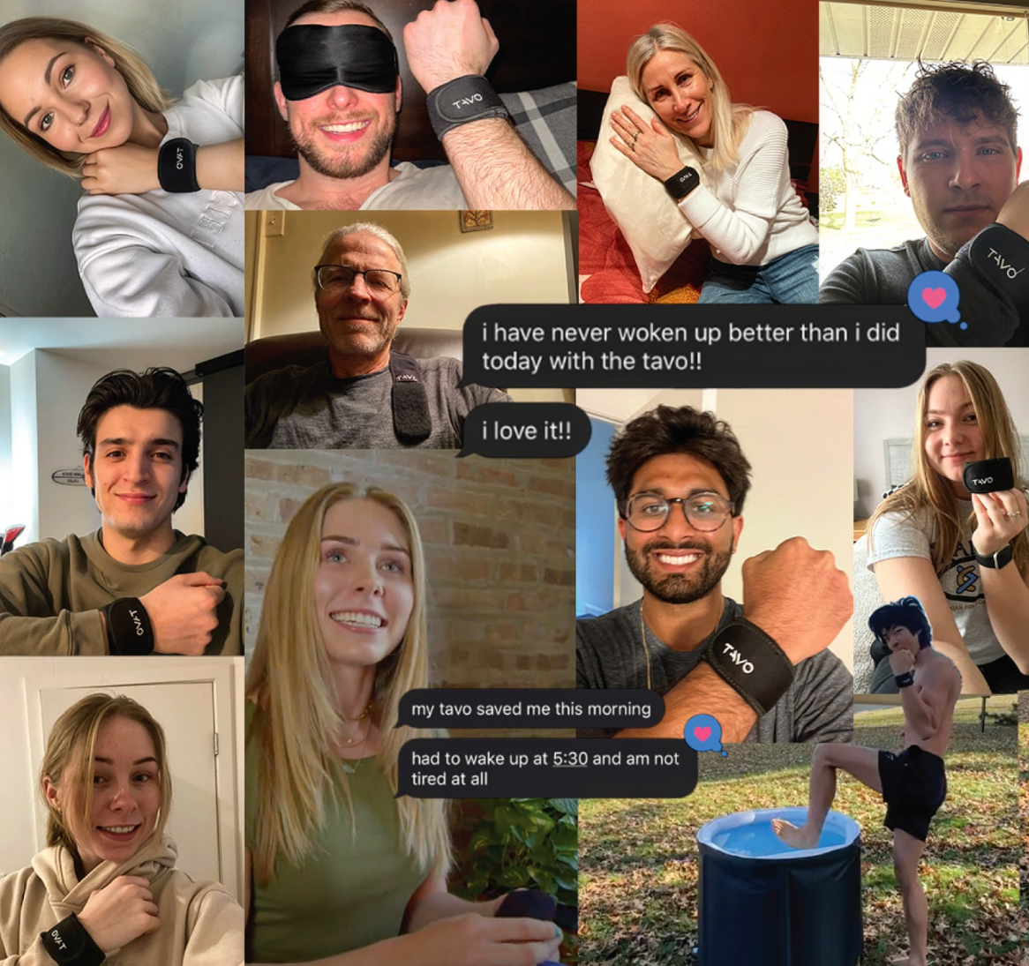
Final Points
TAVO is seen as useful and provides a valuable solution to customer problems.
Room for growth exists in improving customer satisfaction and engagement.
Regular customer surveys will help drive this engagement and deepen understanding of customer needs.
Survey data collected provides valuable insights to inform future improvements.
Customer feedback will be essential for shaping TAVO’s development and success moving forward.

Slide 35
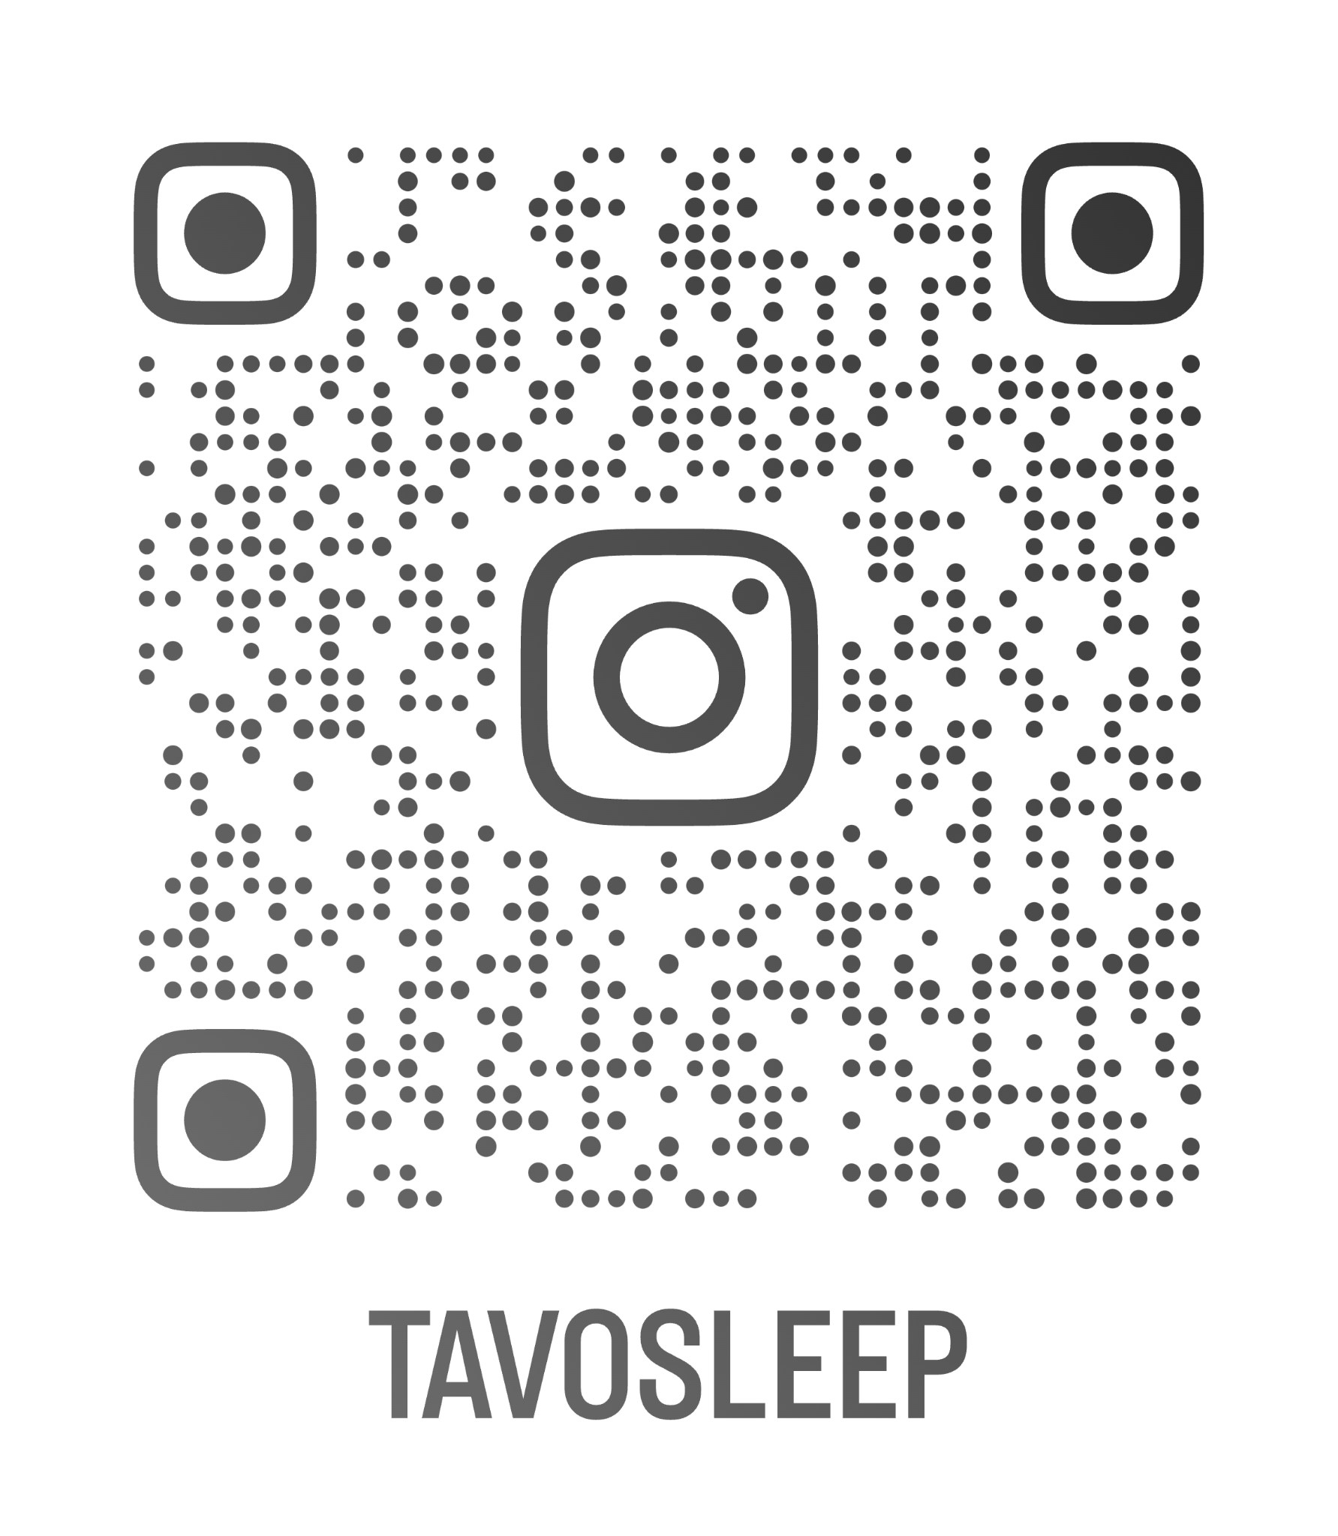
Q & A
Thank you for listening!
www.tavosleep.com

